Slide 1
ER to Relational Model
Dr. S. RENUKA DEVI
Associate Profesor
SCSE
VIT Chennai Campus

Slide 2
ER-to-Relational Mapping Algorithm
A seven-step algorithm is used to convert the basic ER model constructs into relations

Slide 3
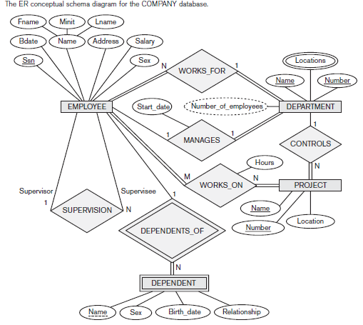

Slide 4
1. Mapping of regular entity types
For each regular (strong) entity type E in the ER schema, create a relation R that includes all the simple attributes of E
Include only the simple component attributes of a composite attribute
Choose one of the key attributes of E as the primary key for R
If the chosen key of E is a composite, then the set of simple attributes that form it will together form the primary key of R
sometimes called entity relations because each tuple represents an entity instance

Slide 5
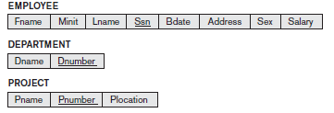
Mapping of regular entity types (Contd…)
Example:

Slide 6
2. Mapping of Weak Entity Types
For each weak entity type W in the ER schema, create a relation R and include all simple attributes of W as attributes of R
In addition, the primary key attribute(s) of the relation(s) that correspond to the owner entity type(s) are included as foreign key attributes of R
The primary key of R is the combination of the primary key(s) of the owner(s) and the partial key of the weak entity type W, if any
If there is a weak entity type E2 whose owner is also a weak entity type E1, then E1 should be mapped before E2 to determine its primary key first

Slide 7

Mapping of Weak Entity Types (Contd…)
Example:

Slide 8
3. Mapping of Binary 1:1 Relationship Types
For each binary 1:1 relationship type R in the ER schema
Identify the relations S and T that correspond to the entity types participating in R
Apply any one of the following three possible approaches
The foreign key approach
The merged relationship approach
The cross reference or relationship relation approach

Slide 9

Mapping of Binary 1:1 Relationship Types (Contd…)
Foreign key approach
Choose one of the relations—S,—and include the primary key of T as a foreign key in S
It is better to choose an entity type with total participation in R in the role of S
Include all the simple attributes of the 1:1 relationship type R as attributes of S

Slide 10
Mapping of Binary 1:1 Relationship Types (Contd…)
Merged Relationship Approach
An alternative mapping of a 1:1 relationship
merge the two entity types and the relationship into a single relation
This is possible when both participations are total

Slide 11
Mapping of Binary 1:1 Relationship Types (Contd…)
Cross-reference or relationship relation approach
set up a third relation R for the purpose of cross-referencing the primary keys of the two relations S and T representing the entity types
The relation R is called a relationship relation (or sometimes a lookup table)
The relation R will include the primary key attributes of S and T as foreign keys to S and T
The primary key of R will be one of the two foreign keys
The drawback is having an extra relation

Slide 12
4. Mapping of Binary 1:N Relationship Types
For each regular binary 1:N relationship type R,
Identify the relation S that represents the participating entity type at the N-side of the relationship type
Include the primary key of the relation T that represents the other entity type participating in R as foreign key in S
Include any simple attributes of the 1:N relationship type as attributes of S.

Slide 13
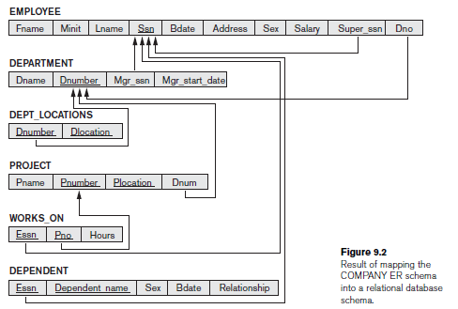
Mapping of Binary 1:N Relationship Types

Slide 14

5. Mapping of Binary M:N Relationship Types
For each binary M:N relationship type R
Create a new relation S to represent R
Include the primary keys of the relations that represent the participating entity types as foreign key attributes in S
The above combination will form the primary key of S
Also include any simple attributes of the M:N relationship type

Slide 15

6. Mapping of Multivalued Attribute
For each multivalued attribute A,
create a new relation R
This relation R will include an attribute corresponding to A, plus the primary key attribute K—as a foreign key in R—of the relation that represents the entity type or relationship type that has A as a multivalued attribute
The primary key of R is the combination of A and K
If the multivalued attribute is composite, we include its simple components

Slide 16
7. Mapping of N-ary Relationship Types
For each n-ary relationship type R, where n > 2,
Create a new relation S to represent R
Include as foreign key attributes in S, the primary keys of the relations that represent the participating entity types
Also include any simple attributes of the n-ary relationship type as attributes of S
The primary key of S is usually a combination of all the foreign keys that reference the relations representing the participating entity types

Slide 17
Any Queries?

